Slide 1

Bubble
Team 4 (Hun-Min Park, Sang-Gyun An, JongMin Jin)

Slide 2
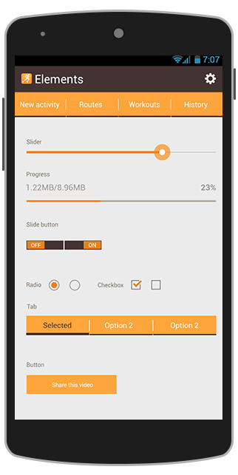
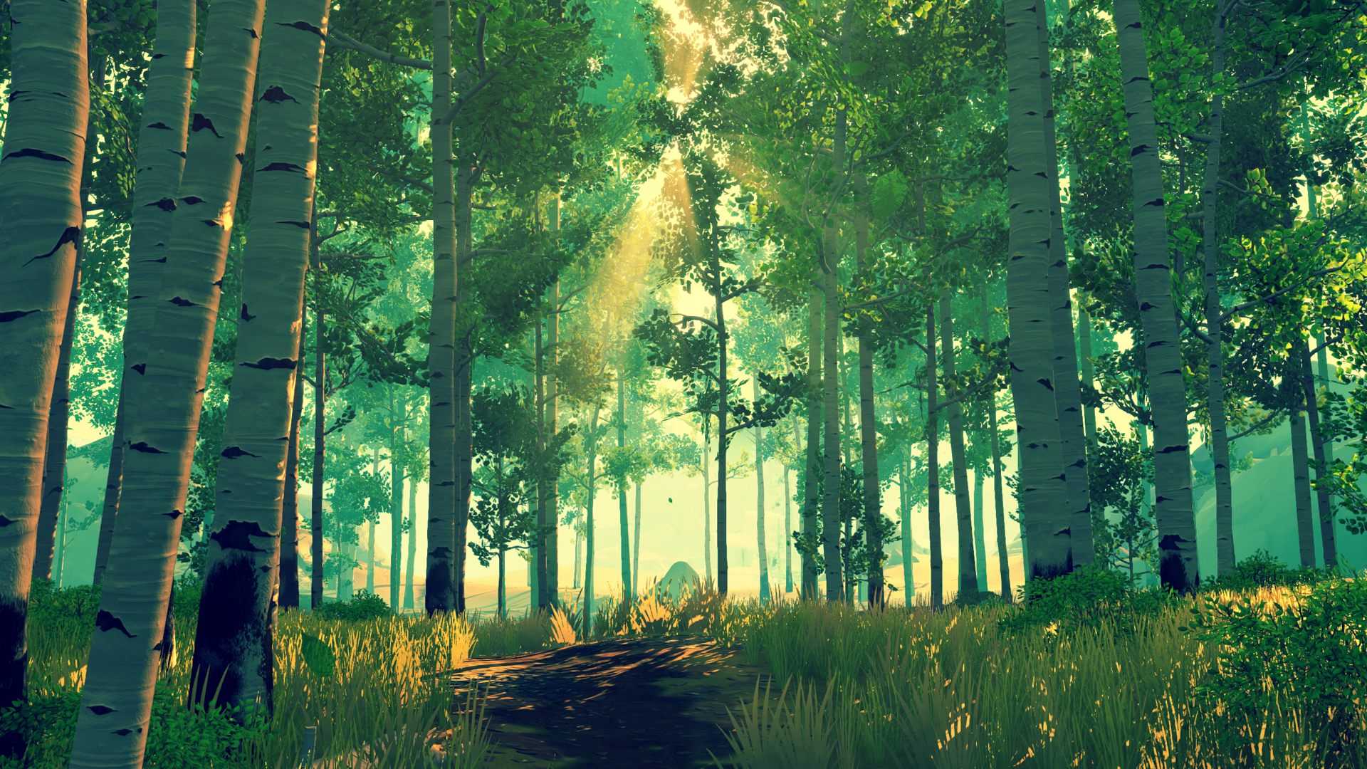



Start
Flying
Let’s blow a virtual bubble!
Notes:
As you know, our game is about blowing bubble.

Slide 3
Project schedule
Step 1
Project
Setup
Step 2
Basic graphics
&
physics
Step 3
Advanced graphics
Step 4
Alpha ver.
Step 5
Beta ver.
Presentation 1 (10/13)
Presentation 2
(11/03)
Presentation 3 (11/17)
Presentation 4
(12/01)
Final
(12/14)
Notes:
Today, as a final presentation, I’d like to recap all the things we have done for the project, quickly.

Slide 4
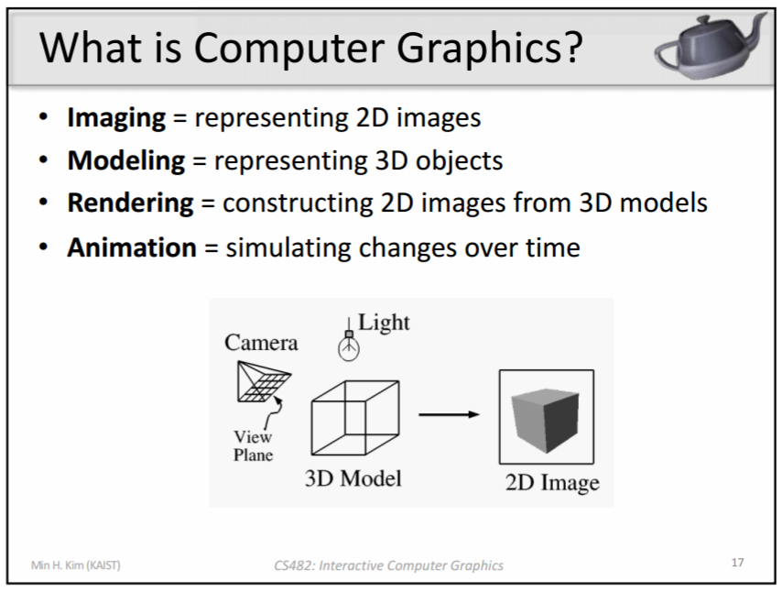
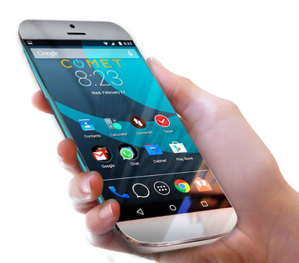
What we wanted explore: 4 keywords
Interaction
Notes:
From the beginning, we had four keywords to explore in interactive computer graphics course.
Which are..
I think, by doing our project, we kind of successfully explored all four keywords.

Slide 5
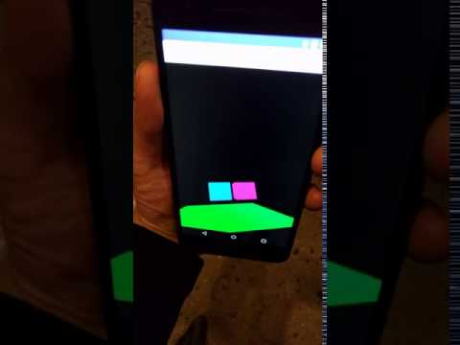
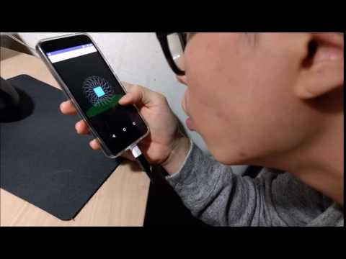
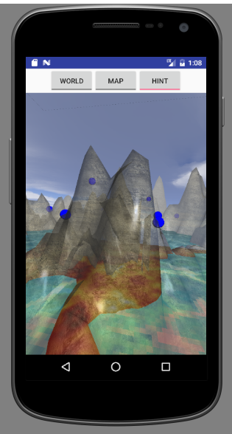
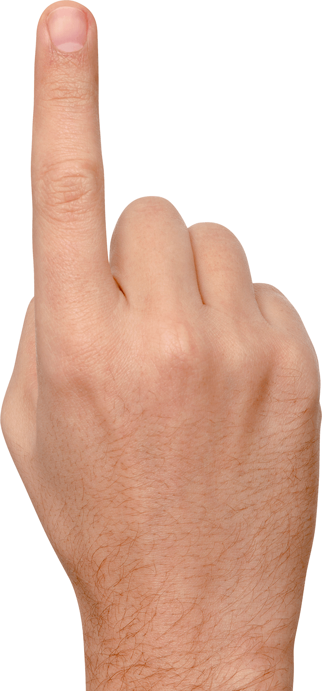
Interaction: How to apply sensor value to graphics?
Gyro sensor → camera rotation
Mic → model translation
Touch → change render mode (transparency; GL_BLEND)
Notes:
First, as for interaction, we tried to answer the question: how to apply sensor value to graphics?
We used three different sensors such as gyro sensor to rotate camera, mic to translate model, and touch to toggle the render mode.

Slide 6
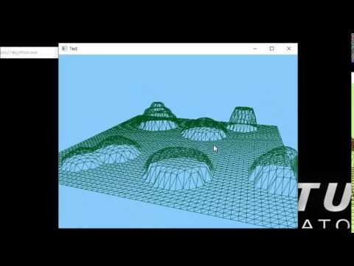
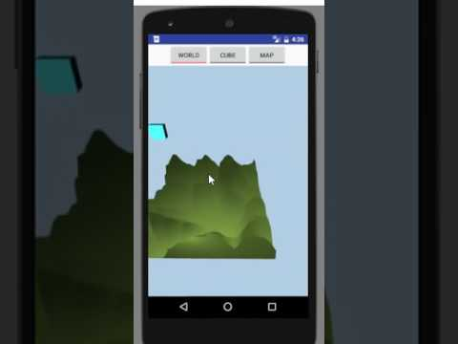
Modeling: How to algorithmically generate a Map model?
Using Gaussian function
Using diamond-square algorithm
Using perlin noise algorithm
Notes:
As for modeling, we didn’t use some existing model, but tried to figure out how to algorithmically generate a map model?
Thus, we have tried gaussian function, diamond-square algorithm, and perlin noise algorithm to make map.

Slide 7
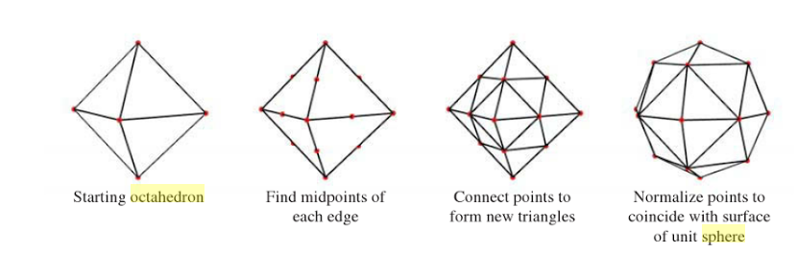
Modeling: How to algorithmically generate a Bubble model?
Subdivision algorithm
+ item model
Notes:
Also, our bubble and items are generated by subdivision algorithm.
So, we can easily change a resolution of polygons of our models.

Slide 8
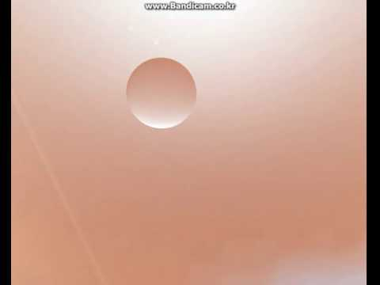
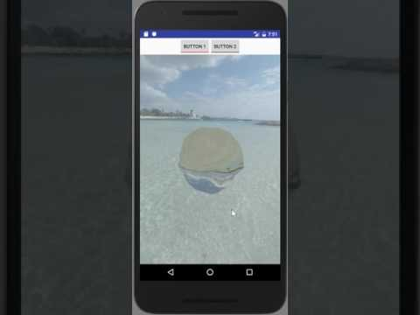
Rendering: How to render realistic bubble?
Cube mapping
Alpha blending
Refraction
Notes:
As for rendering, we tried to render a realistic bubble.
Thus, we used cube mapping, alpha blending, and concept of fraction.

Slide 9
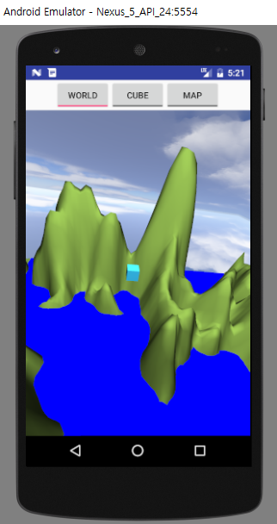
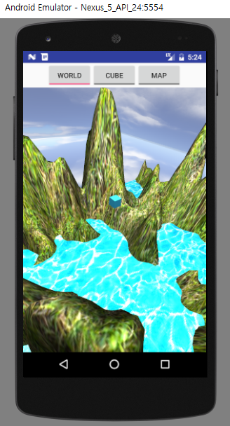
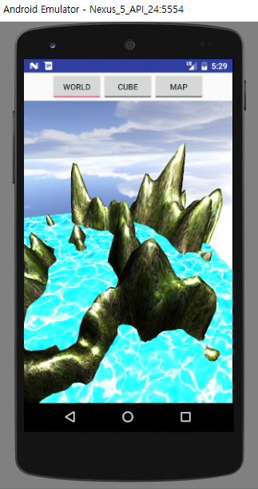
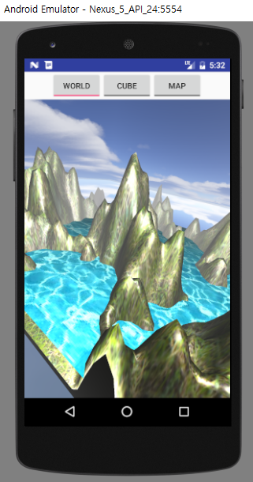
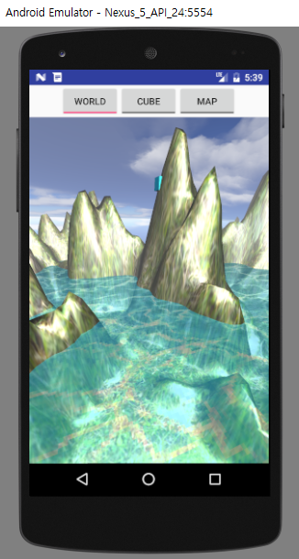
Rendering: How to render realistic map? (1)
Diffuse + Blinn-phong -> Shading of the map
Diffuse
Texture mapping
Blinn-phong shading
Haze effect
Alpha blending
Notes:
Also, we tried many things for realistic map.
From the basics diffusion, texture mapping, blinn-phong shading to some techniques including haze effect, alpha blending

Slide 10
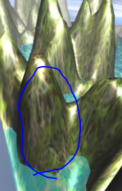
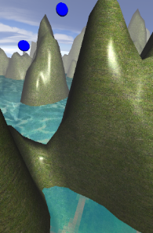
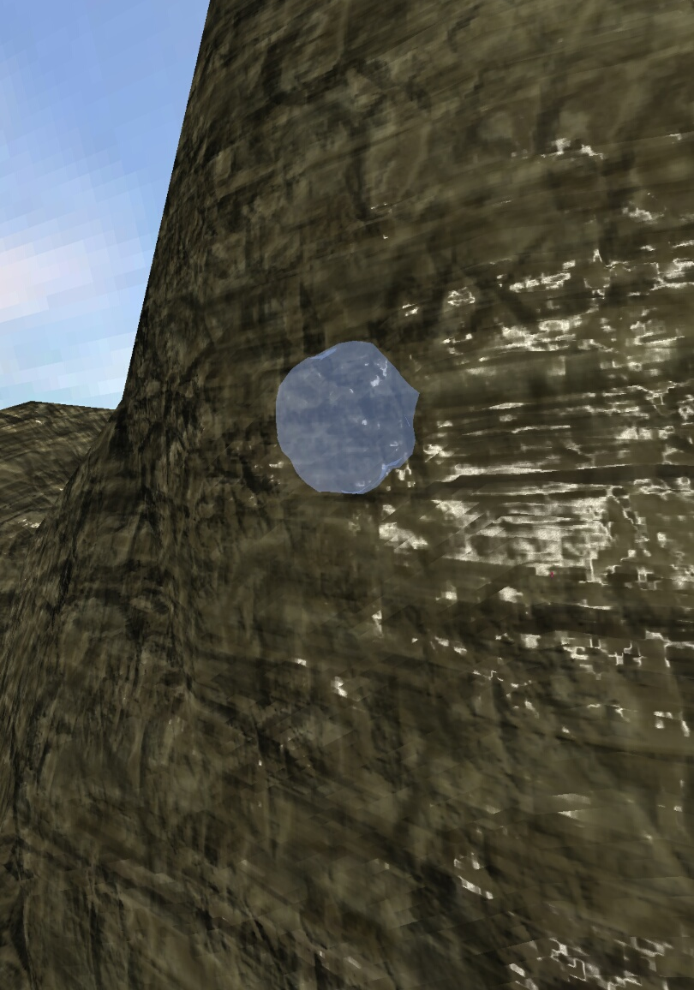
Rendering: How to render realistic map? (2)
Tri-planar + Normal(bump) map -> Solved texture distortion, Realistic shading
Distortion!
Tri-planar mapping
Tri-planar bump mapping
Notes:
Moreover, we applied tri-planar mapping to overcome distortino issue, and bump mapping for realistic look of mountain.

Slide 11
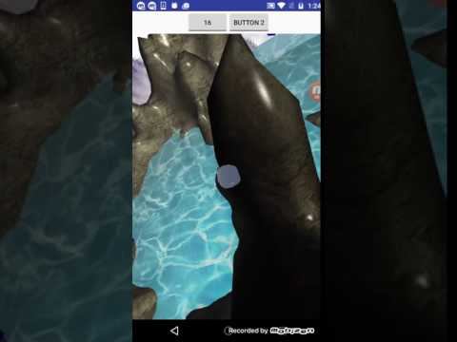
Animation: How to animate waving sea naturally?
Texture mapping according to time
Notes:
As for animation, we try to reproduce waving sea by updating texture mapping according to time.

Slide 12
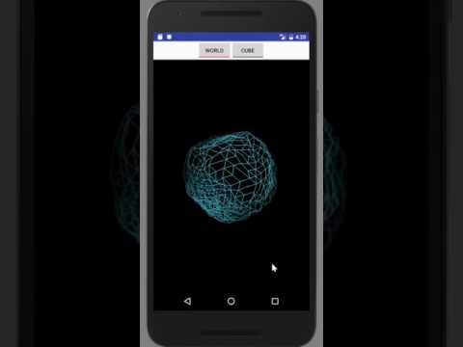
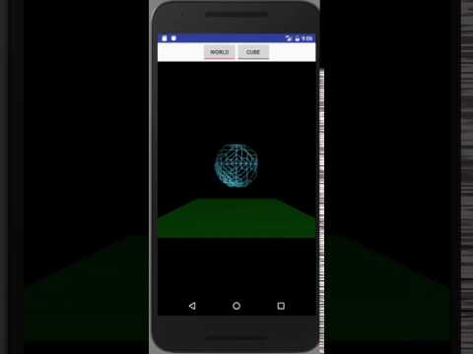
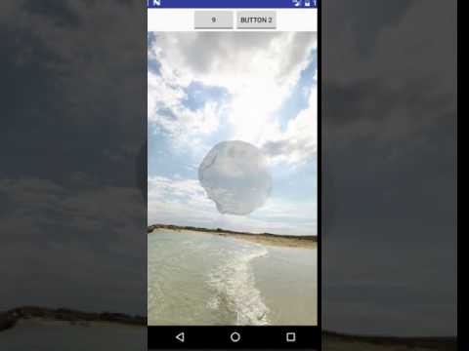
Animation: How to animate bubble naturally?
Basic physics simulation (F=ma)
Spring-mass model, locomotion under gravity, shrinking
Notes:
Also, for natural behavior of bubble, we implemented basic physics including spring-mass model, locomotion under gravity, and natural shrinking.

Slide 13
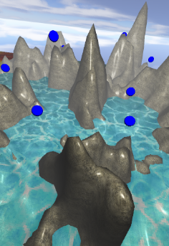
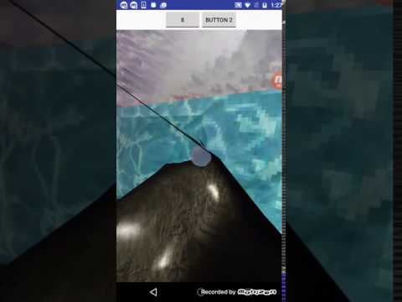
Technical setup - Item generator / collision detection
Items’ locations
Collision detection
Notes:
Furthermore, there are several technical setup for game, such as Item generator or collision detection.

Slide 14
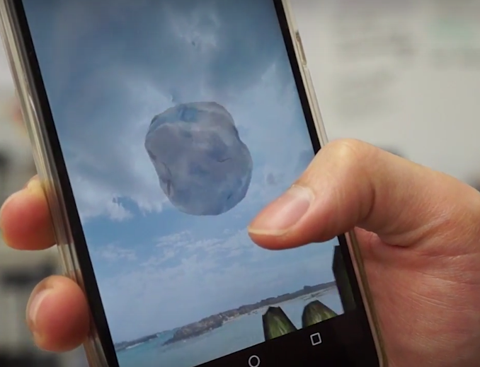
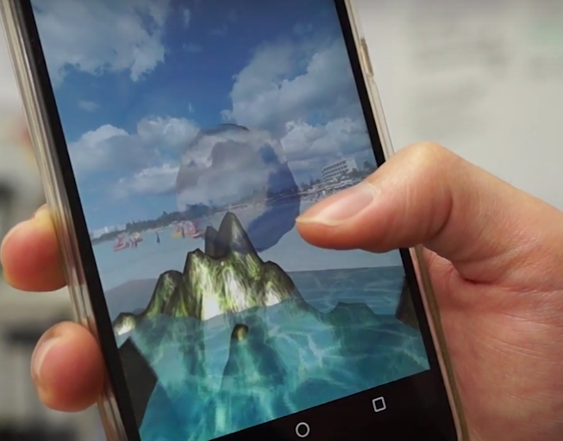
Heuristic evaluation with users
“It is too hard to play”
Adjust the # of items (50 → 30)
“I don’t feel bubble shrinking”
Increase the speed of shrinking
“I think gravity is too weak”
Increase gravity constant
“Mic is too sensitive, it is even influenced by background noise”
Lowering sensitivity of mic
“Tutorial page is needed”
Inserting a tutorial page
Notes:
At last, from user study, we could several parameter for playability.

Slide 15
Game interface walk-through

Slide 16
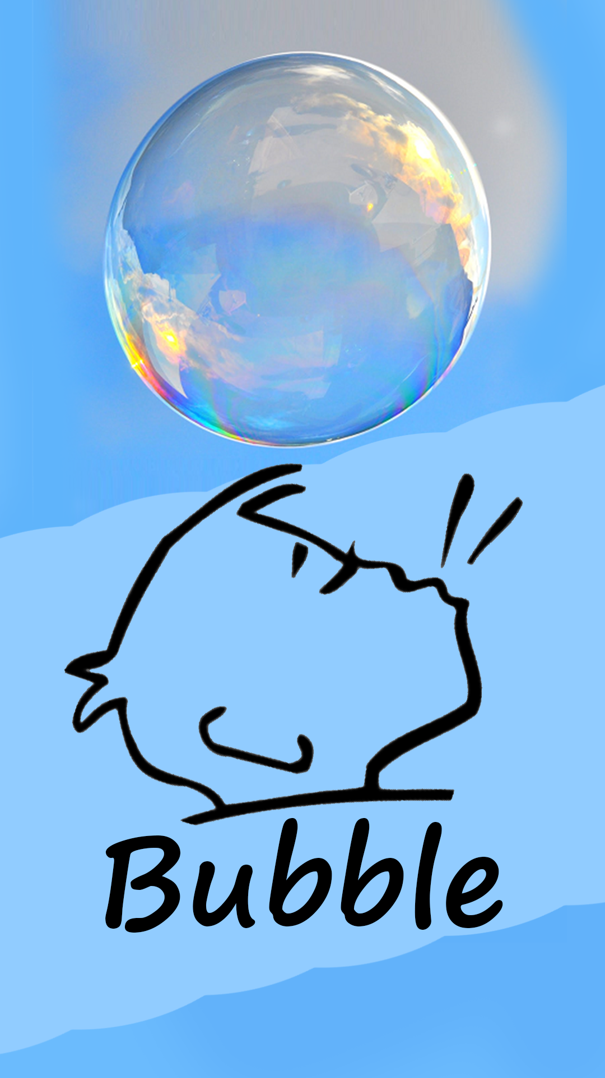
Title screen
Notes:
This is our title screen

Slide 17
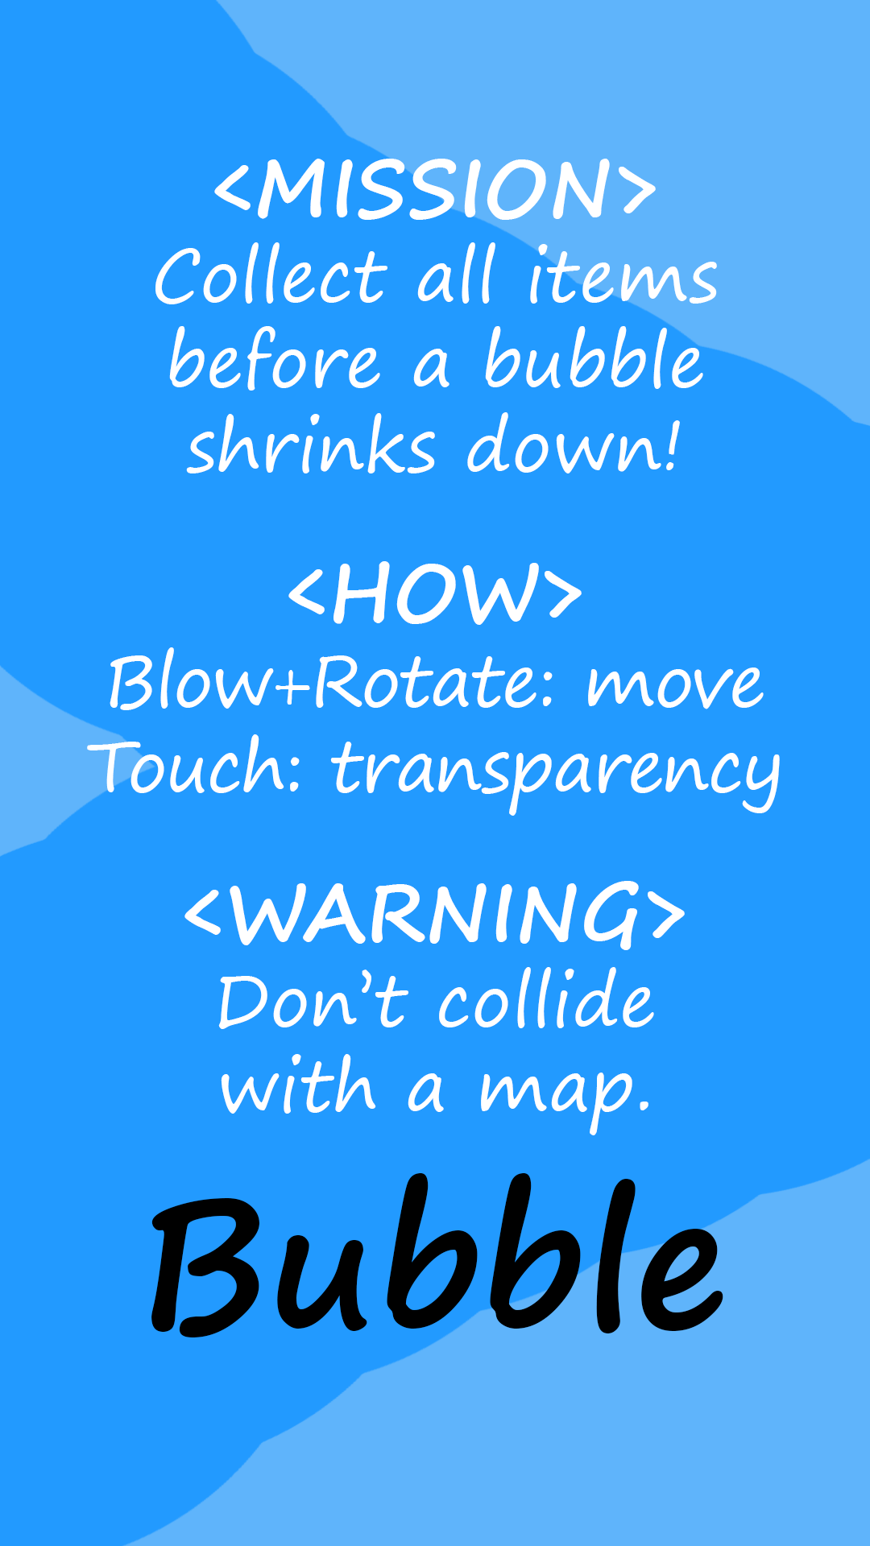
How to play
Notes:
After that, quick tutorial screen including mission, how to play, and rule.

Slide 18
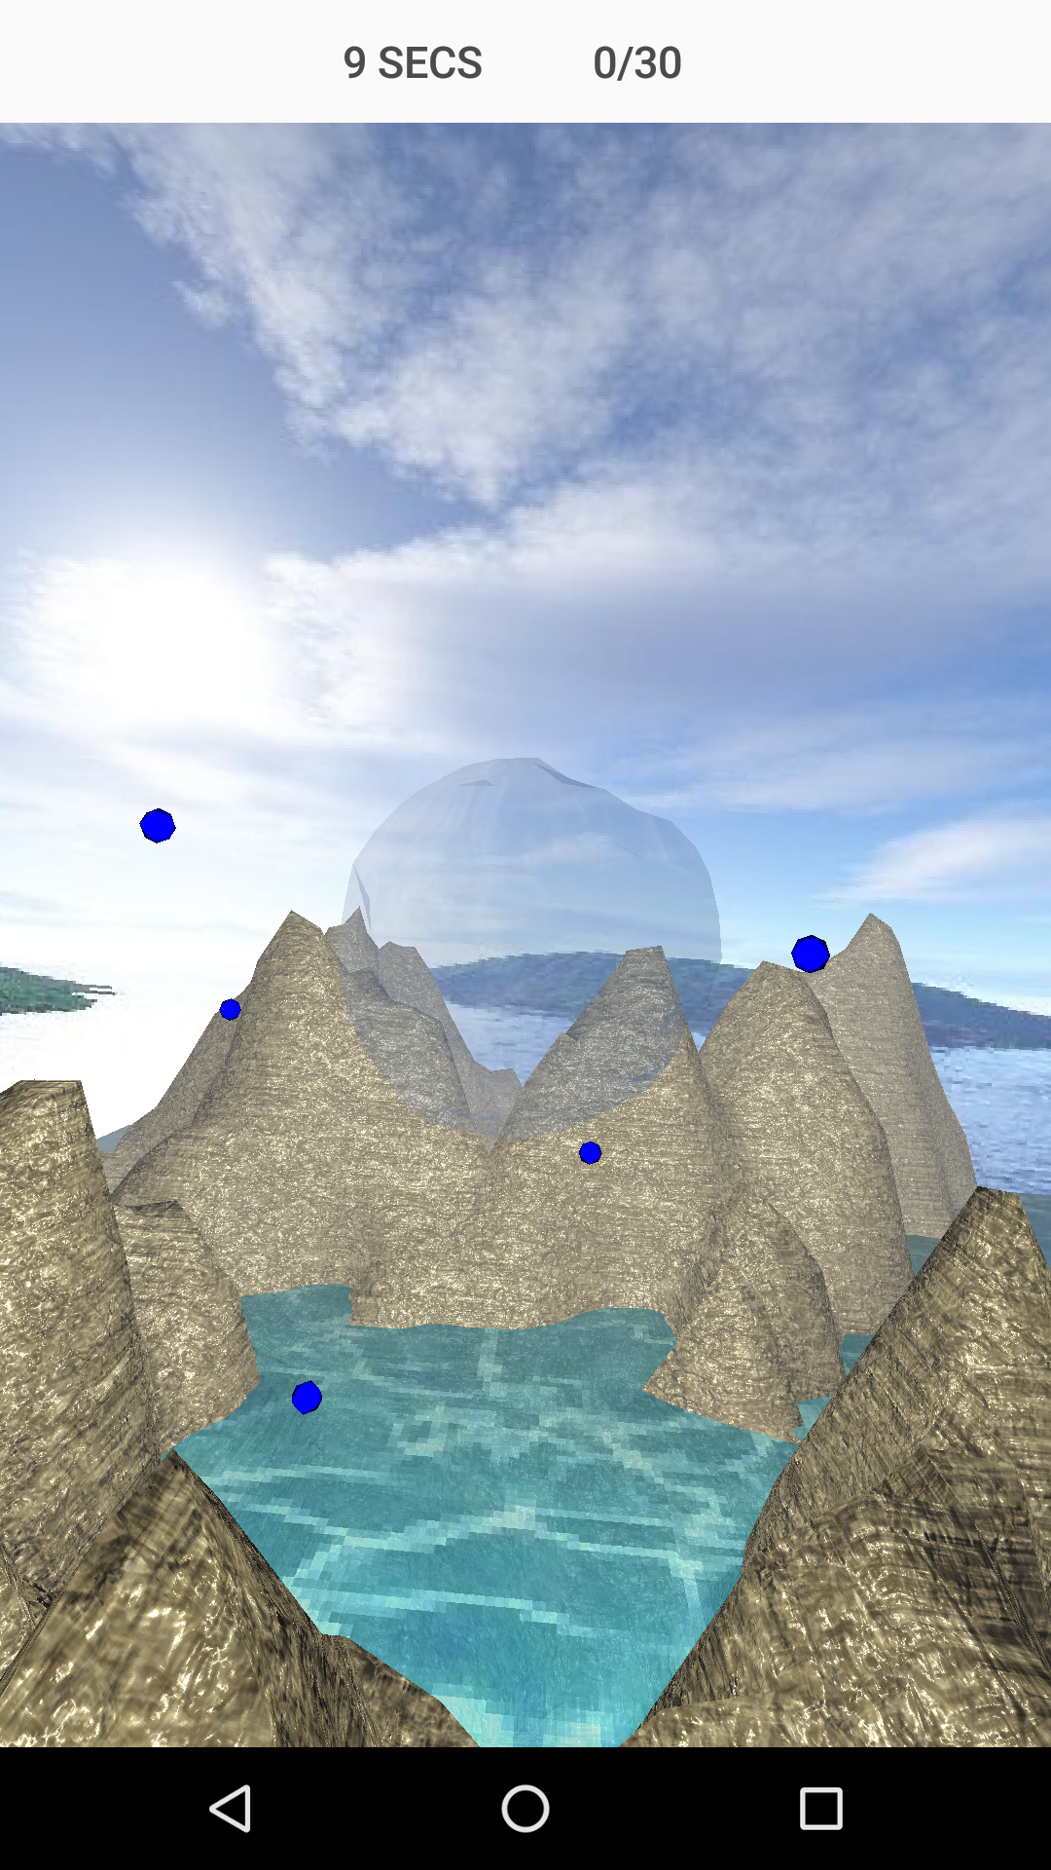
Gameplay
Notes:
This ia gameplay screen.

Slide 19
# of collected items
# of total items
Play time
Bubble
Item(s)
Notes:
At the top of the screen, there are playtime and information about collected items and total items.

Slide 20
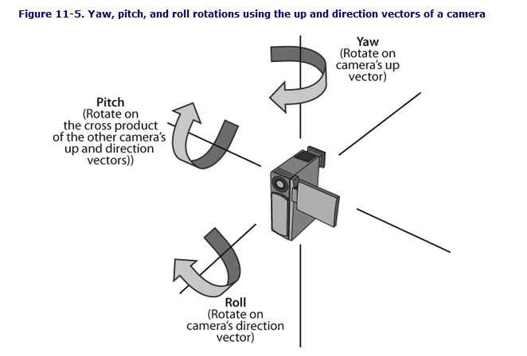
Notes:
To move bubble in specific direction, user should rotate the device and blow in front of the mic.

Slide 21
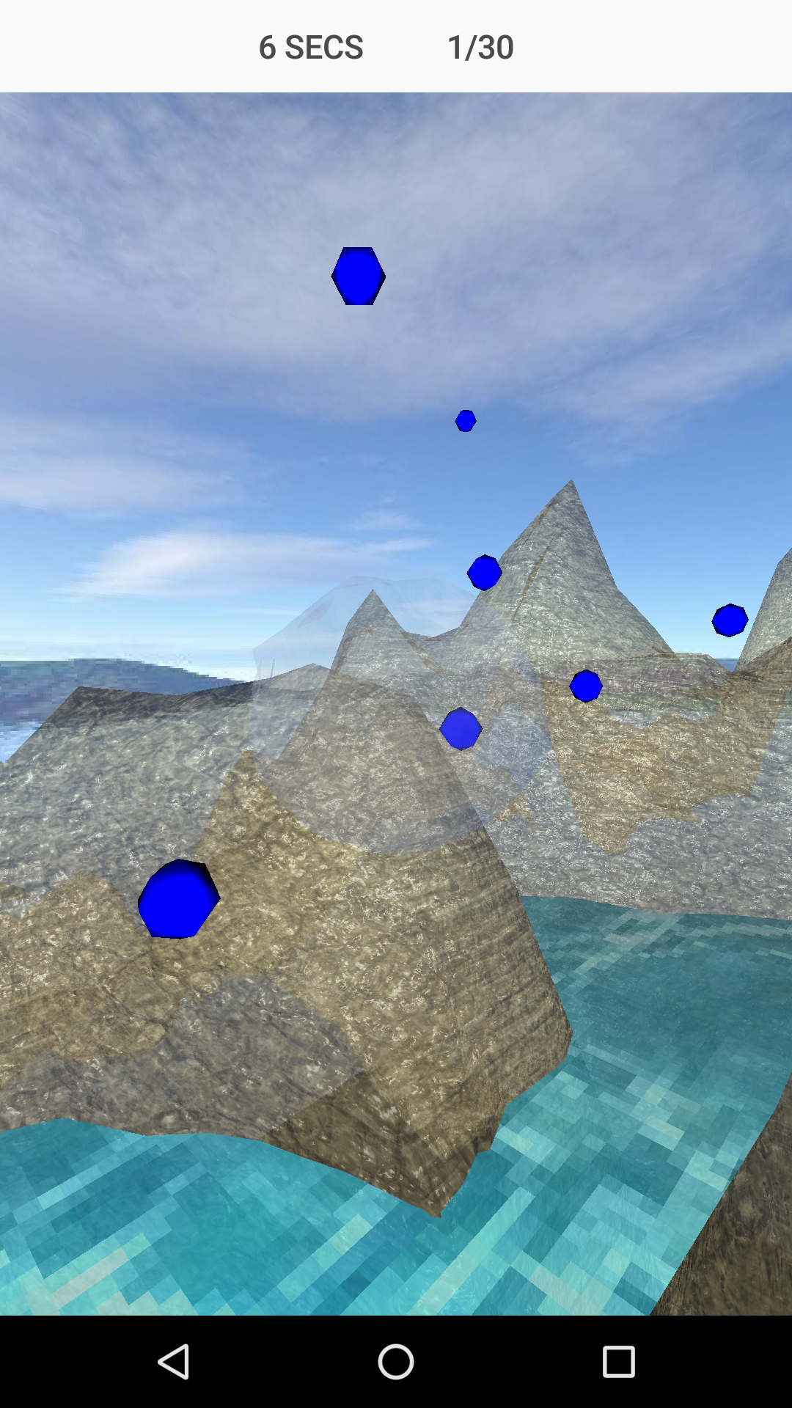
Touch -> Hint mode
Notes:
Mountains become transparent when touching on screen.
User can see through the mountain and find the items behind them.

Slide 22

If you collect all items.
Notes:
Game clear screen appears when you collect all items.

Slide 23
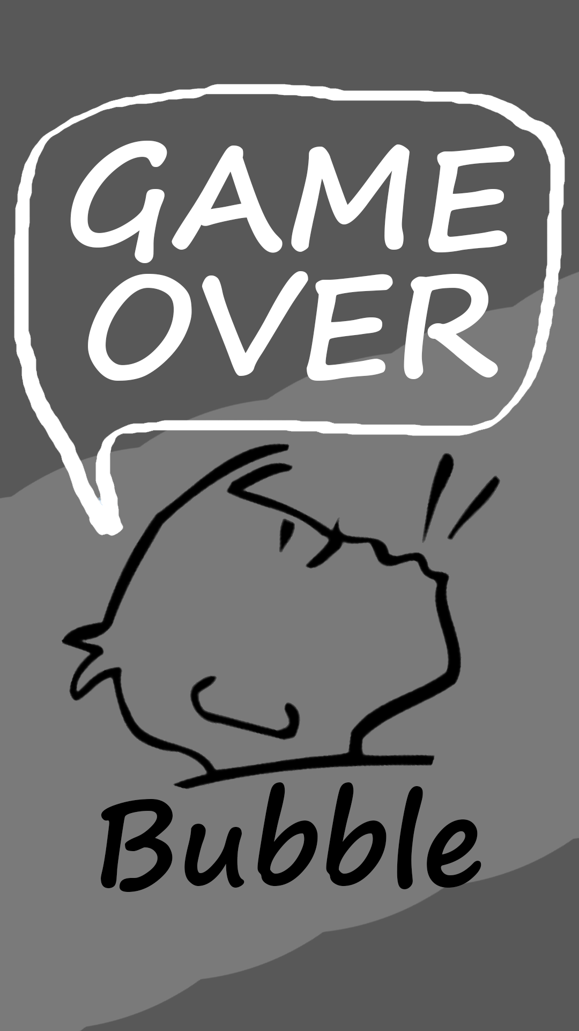
If you collide with a map.
If bubble shrinks down.
Notes:
But game over screen will poped up, if you collide with a map or bubble shrinks down too much.

Slide 24
Thank U

